Slide 1
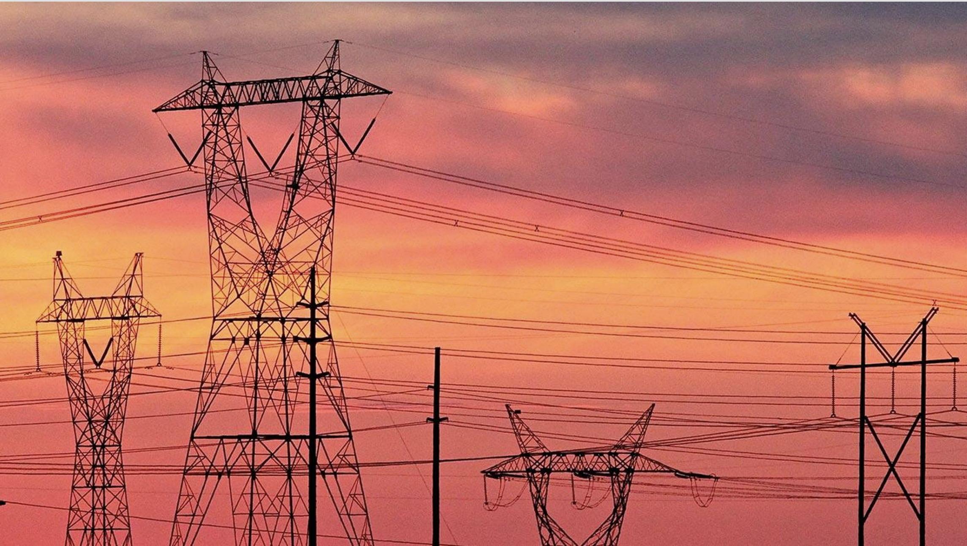
The Electric Grid in Evolution:
Data, Optimization and Risk-Taking
Daniel Bienstock, Columbia University
Fri.Oct.13.201846.2023@racingstripe.local

Slide 2
People who do all the work Collaborators
Richard Waltz, Artelys (Knitro)
Ed, Tobi, Pierre, Jarek, Gurobi
Yury Dvorkin, Johns Hopkins EE
Agostino Capponi, Garud Iyengar, Christian Kroer, Columbia, Misha Chertkov, Arizona, Cheng Guo, Clemson
Matías Villagra, PhD student, Columbia
Andrea Brickey, Amy McBrayer and Alexandra Newman
PSERC

Slide 3
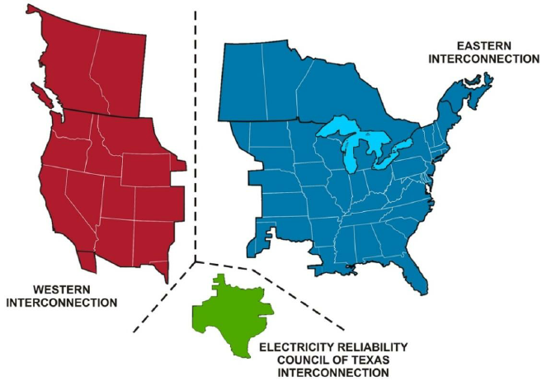
North American power map
Three separate electrical circuits
Except for Texas, too large to control as one unit

Slide 4
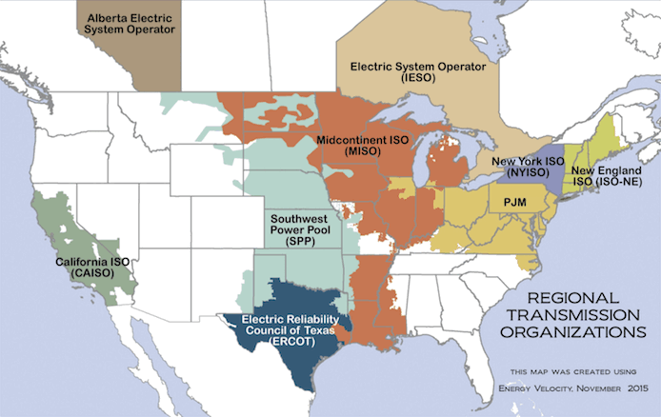
ISOs: Independent System Operators
RTOs: Regional Transmission Operators
Each ISO/RTO controls the grid in its territory
Power can travel between neighboring entities, but in a constrained manner
Each entity operates the markets (energy, capacity, and reserves) in its territory

Slide 5
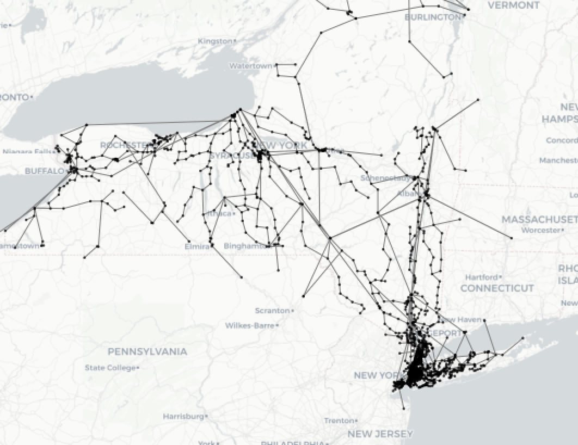
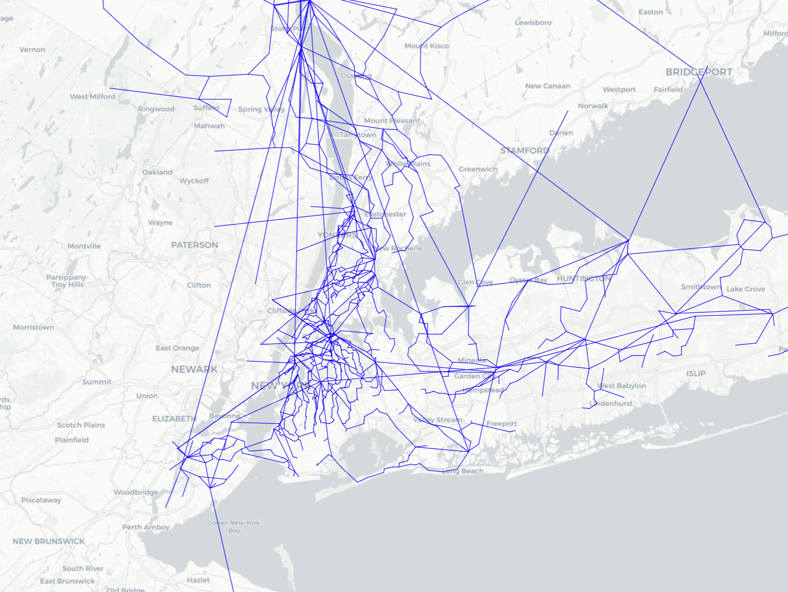
NY ISO system:
1814 buses
500+ generators
33 GW peak load
This is not a very large system

Slide 6
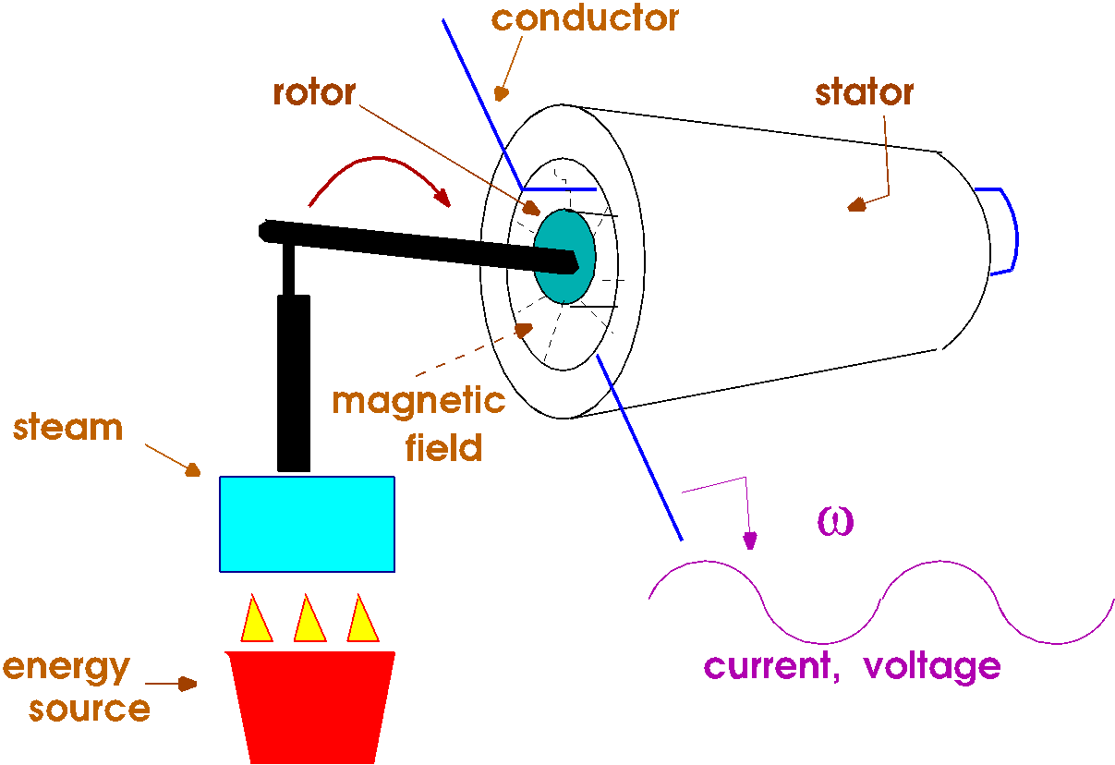
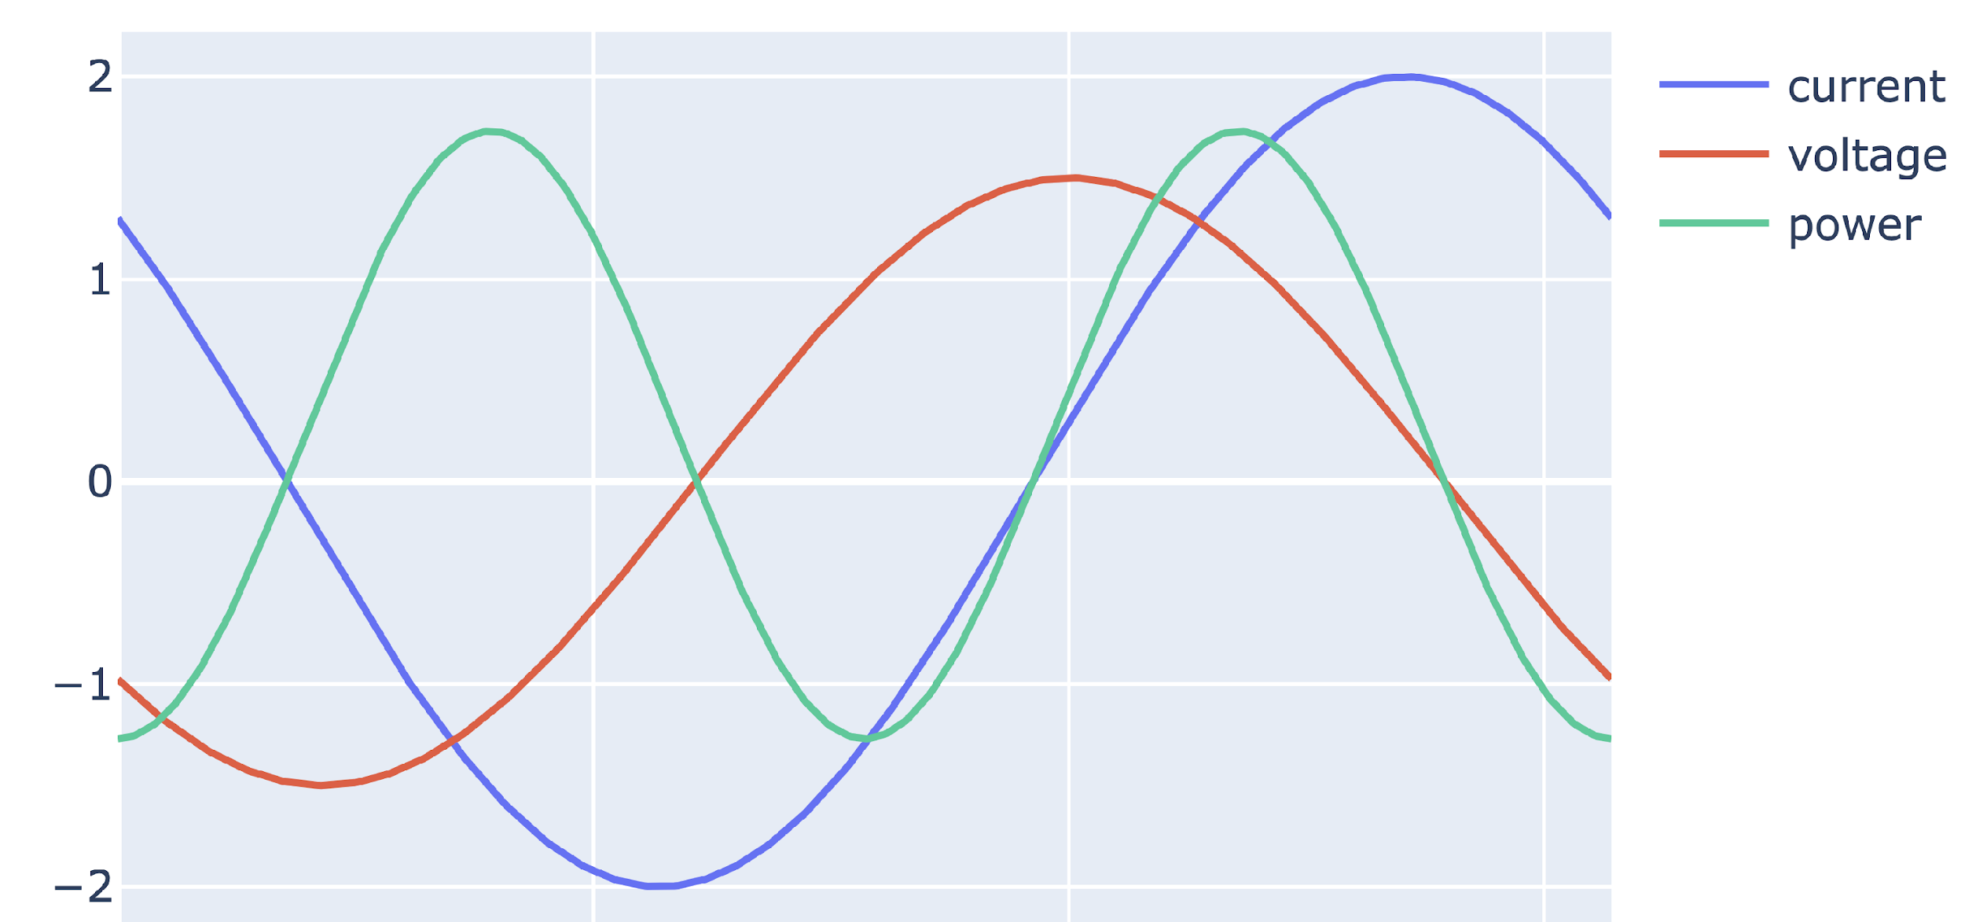
Generator produces
AC current at a given AC voltage
Both at the given frequency (60 Hz or 50 Hz)
Current x Voltage = Power

Slide 7
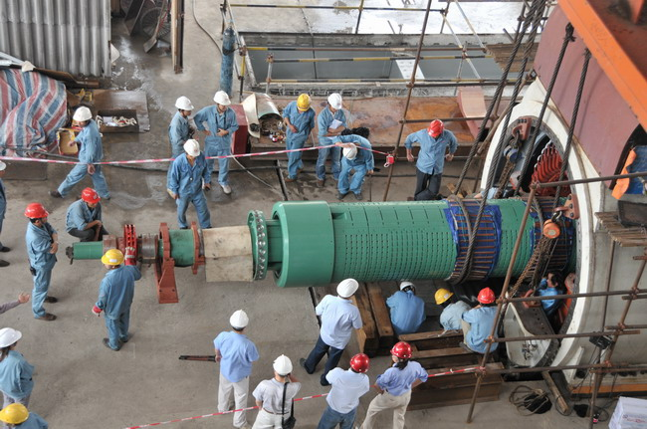
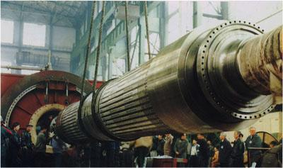

Slide 8
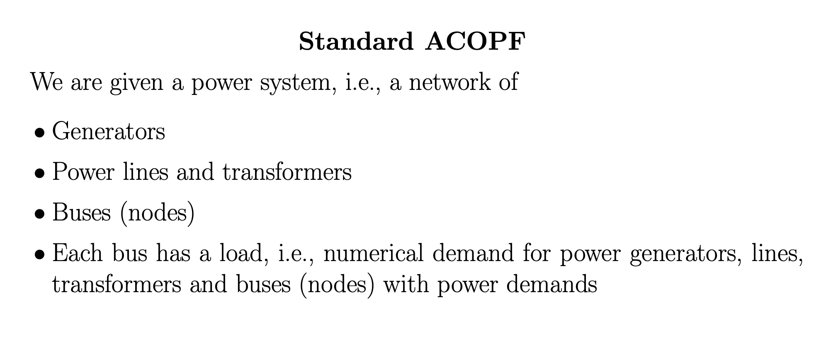
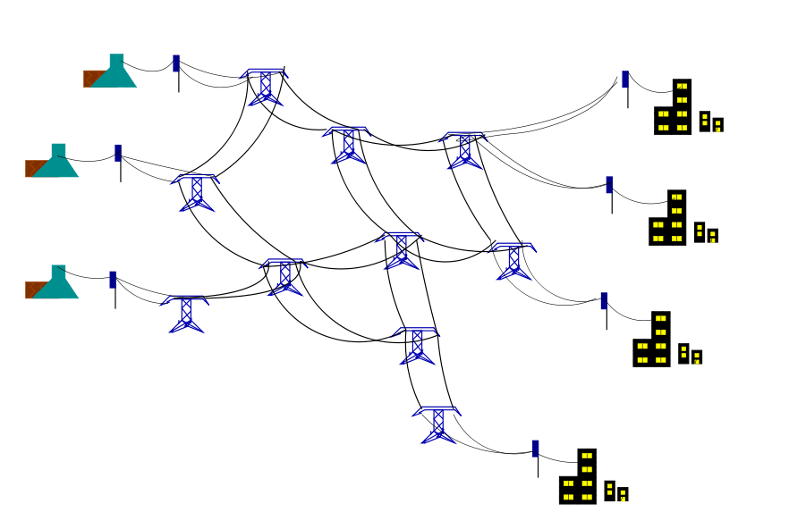
Cost incurred at generators
First formulated around 1960

Slide 10
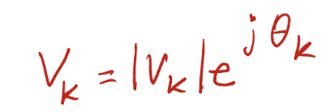
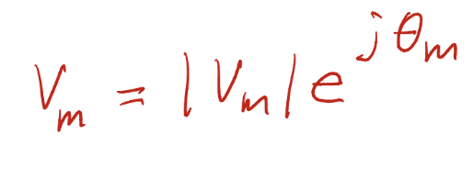
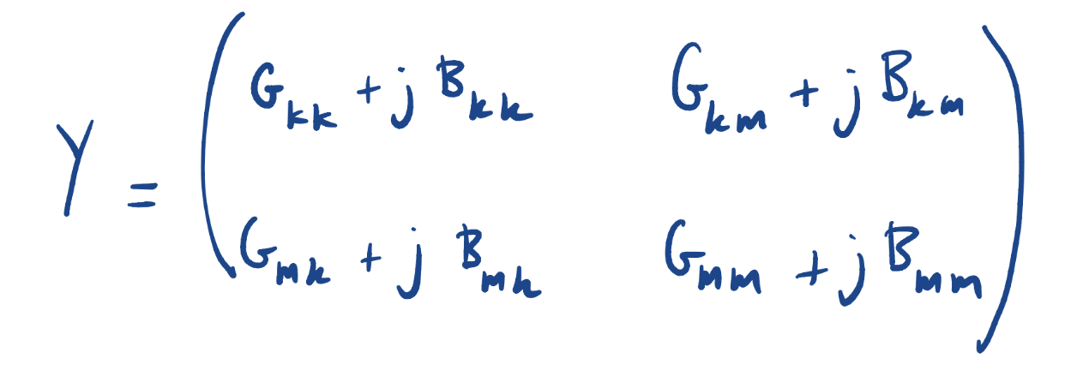
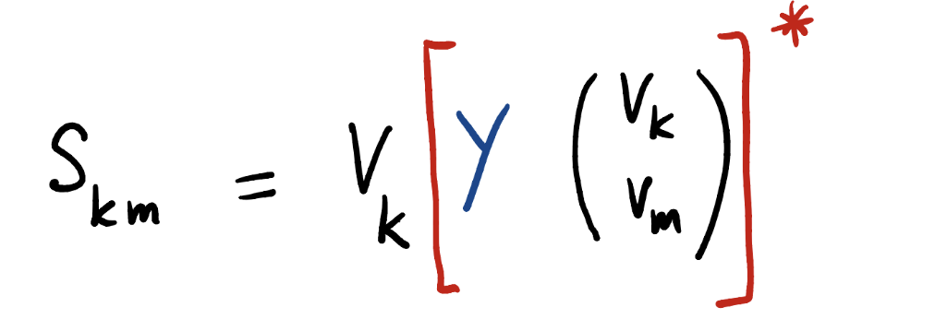
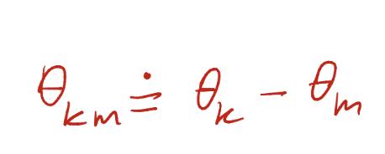
I_{km} I_{mk}
k
S_{km} S_{mk}
m
Ohm’s Law
Complex current
complex power injected into km at k
Admittance matrix for line km
S_{km} != -S_{mk}

Slide 11
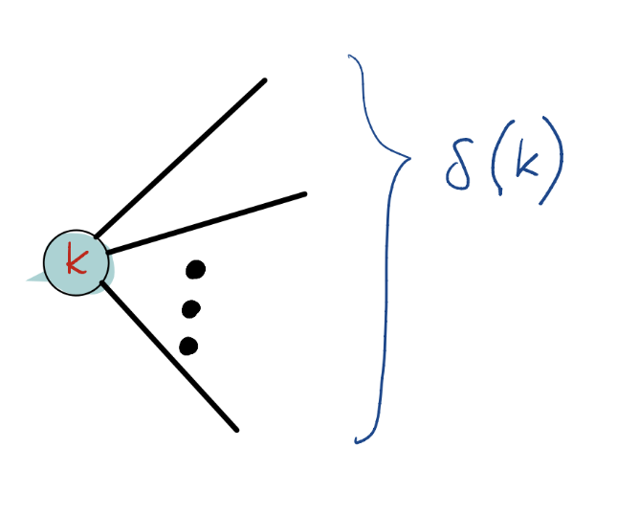
Power injected into grid at a bus =
Generation at bus – Load at bus
“Reactive” power generation/demand at k
LHS = complex power injected into grid at k
Real power demand at k
Total real (“active”) power generated at k

Slide 12
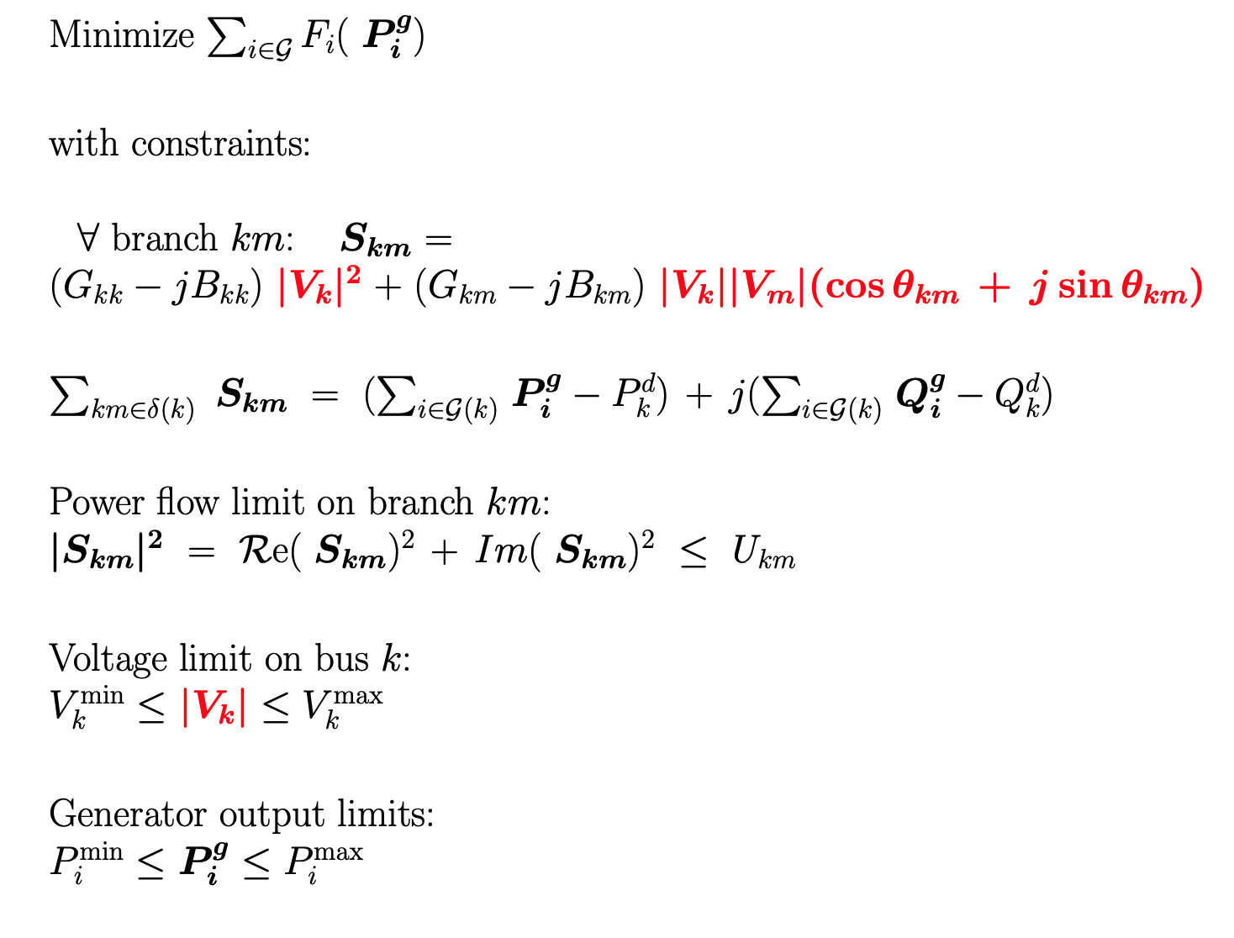
Basic ACOPF

Slide 13
Sample runtimes
Case | # buses | # branches | # generators | Runtime (s) | Solver
118 | 118 | 186 | 54 | 0.76 | MIPS
1354pegase | 1354 | 1991 | 260 | 1.95 | MIPS
ACTIVSg2000 | 2000 | 3206 | 544 | 2.96 | MIPS
3120sp | 3120 | 3693 | 505 | 4.25 | MIPS
9241pegase | 9241 | 16049 | 1445 | 11.78 | MIPS
ACTIVSg70k | 70000 | 88287 | 10390 | 177.83* *Apple M2 | Knitro
Optimal? Near optimal? Any guarantees?

Slide 14
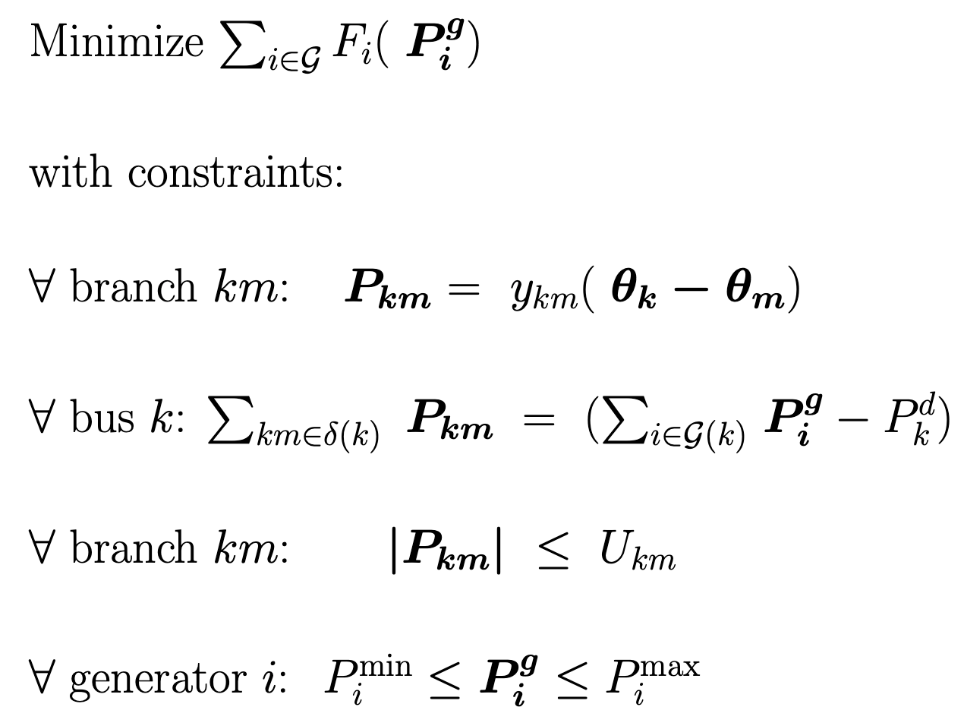
DC approximation -- “good enough” under “normal” conditions
Cost incurred at the generators: piecewise-linear convex
Physics
Power flow balance
Flow limit
Generator limit

Slide 15
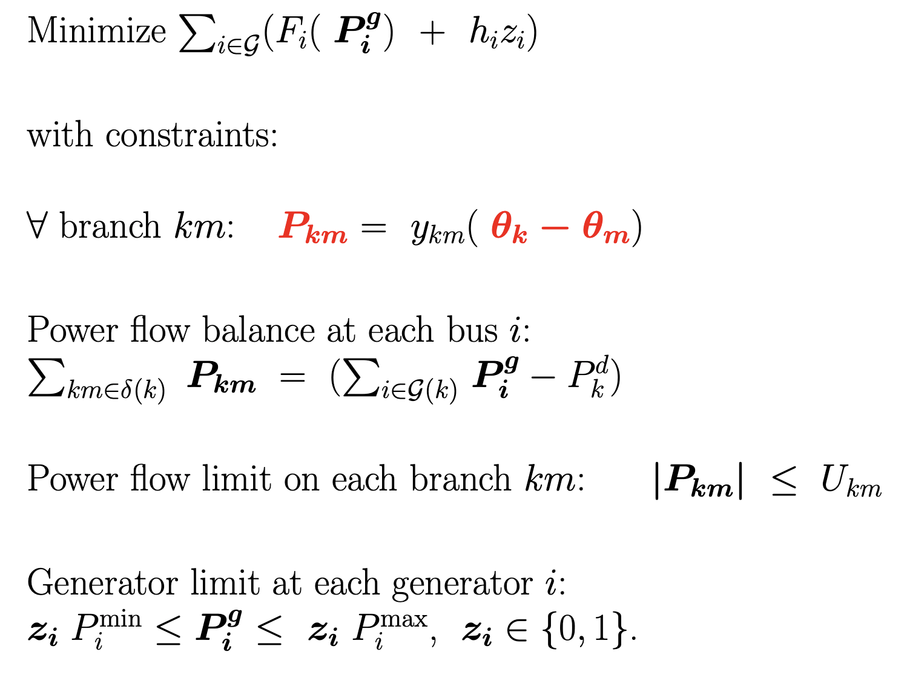
Unit commitment (network aware, single period).
Multi-period model has ramping constraints, plus more

Slide 16
Summary: Network operations
Once a day: day-ahead markets
Plans hourly operations for the next day, based on demand estimates and generator bids.
Multi-period unit-commitment problem.
Typically “security constrained”. Also known as SCUC (security-constrained unit commitment)
After solving, fix binaries, rerun as LP. Duals used as location-based prices for energy (LMPs).
As the day progresses, more restricted/accurate versions of SCUC are run so as to correct schedule.
Near real-time (5 minutes), DC OPF, also known as RT-dispatch.
Duals used as location-dependent prices for energy.
What else:
Real-time balancing provided by serves reserves setup. Paid/bid through a reserves market. Planning also uses LP. Regulation, AGC.
Long-term planning using capacity markets. Also LP/MIP.
Today, AC models are only used for studies or to “make sure” that e.g. RT-dispatch is safe.

Slide 17
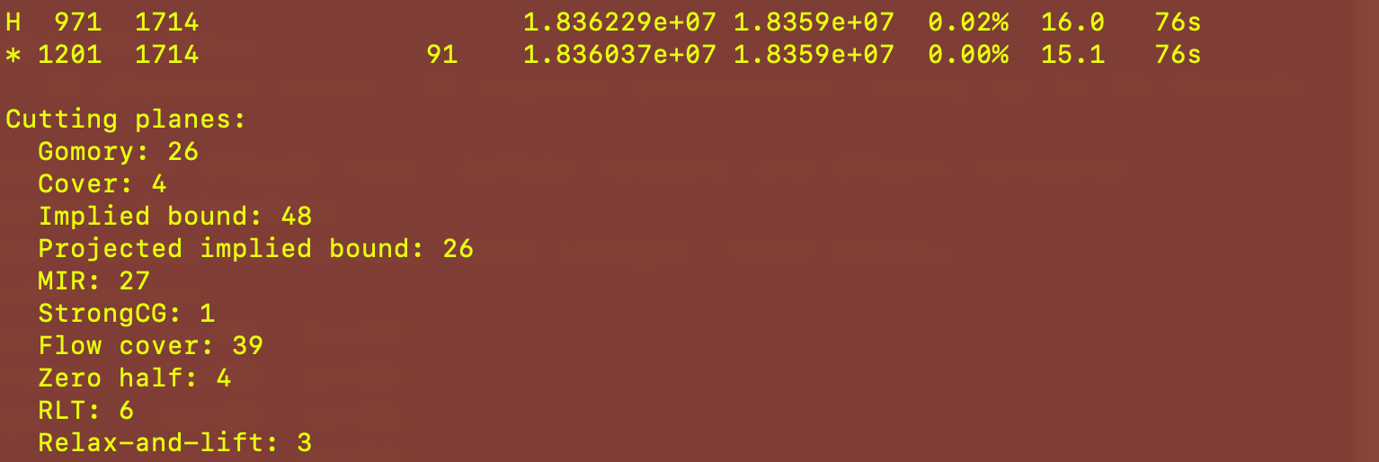
Realistic but synthetic NYISO unit-commitment
24-hour formulation, no contingencies
Loads from August 28, 2018
Gurobi 10.0.01
Model with contingencies requires several hours.

Slide 18
The actual day-ahead practice is complex
Multi-period formulation
Allows generators to turn on and off. Ramping constraints are included in the formulation.
Security-constrained
If one generator or one branch is taken off the system must be able to adjust.
Reserves modeling
Provides some flexibility in the event of forecast error.
Out-of-market corrections and ad hoc rules
Example: uplift charges and other minimum-profit guarantees.
Substantial differences between ISOs
The generic SCUC is an academic model.

Slide 19
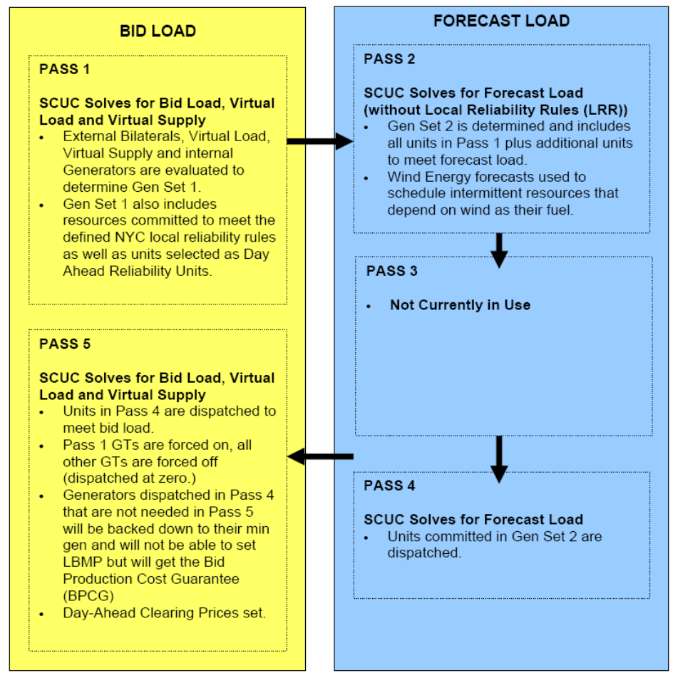
Take-aways
Actual SCUC practices are quite complex, and vary between ISOs.
Uncertainty, and its impact on financials, is a prime concern.
Financial speculation already present.
Real-time volatility not accounted for in the models!

Slide 20
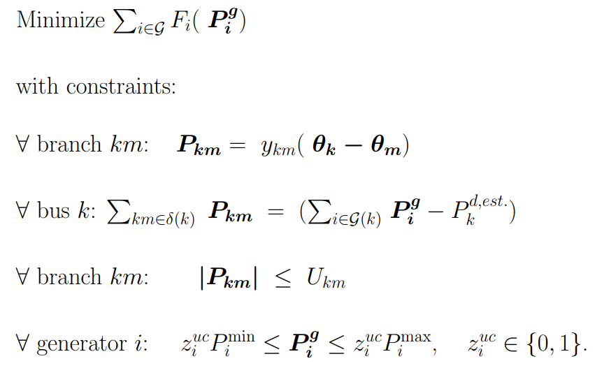
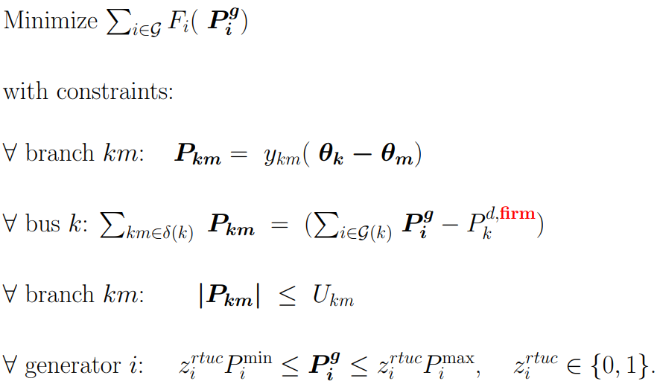
Uncertainty leads to risk
(1) Day-ahead LP, restricted to period t
(2) Real time LP, period t
Issue:
Any excess real-time load is paid at the real-time price
Day-ahead and real-time prices could differ

Slide 21
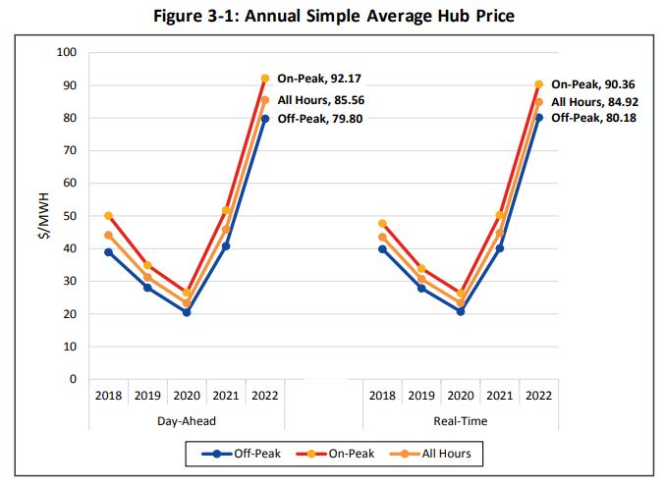
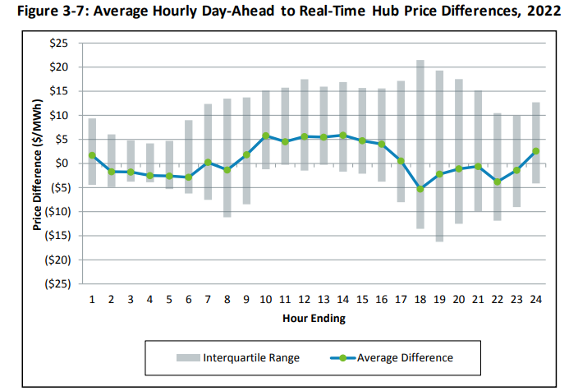
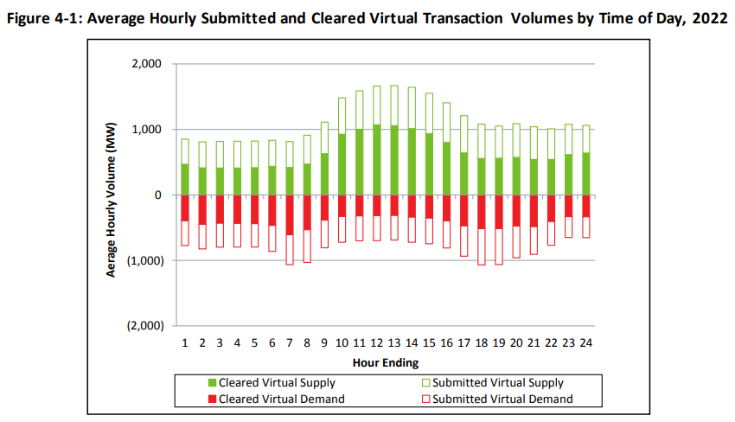
ISO NE average hourly load (2022): 13,576 MWh

Slide 22
Virtual bids
Introduced so as to induce price-convergence, i.e., diminish day-head/real-time price differences
Example:
An agent offers to sell, in the day-ahead market, 100 MWh at $20/hr for tomorrow at 6 PM at location X.
This bid appears as the cost function (curve) for a generator in the SCUC computation.
If cleared by the day-ahead market, tomorrow, that agent will buy 100 MWh at 5 PM at location X, at the real-time prices.
A purely financial transaction. The agent may not own any physical generation assets.
The agent makes money if the real-time price at location X is below the day-ahead price, also at X.
The reverse kind of bid is also an example
Both bids can be entered at once as a compound instrument (i.e., FTR)
Is this real? Is it substantial? Who does it, and why?
More sophisticated instruments?

Slide 23
Is price convergence the only outcome?
From 2022 ISO New England Annual Markets Report (June 2023):
From CAISO “Attachment D” (2023):
ISOs are aware that financial instruments may be used purely with financial profit goals
Empirical evidence suggests that virtual traders may target very narrow time periods of high load/volatility
Physical market participants may hedge their resulting financial risk by taking financial positions
As a result, their physical participation profile may be impacted
Mitigation rules may run into complexity in particular when volatility is present

Slide 24
Ongoing research
Modify the day-ahead markets (SCUC)
What are the goals:
A better representation of real-time volatility and its impact on overall cost
Dispatch of more sophisticated financial instruments
Markowitz-like performance and risk co-optimization
Use an appropriate data-driven representation of volatility (factor stressing)
What are adequate financial instruments? Goal is to reduce the impact of real-time volatility
Ultimately, new laws are needed if the markets are going to actually be revamped
Papers soon coming out …

Slide 25
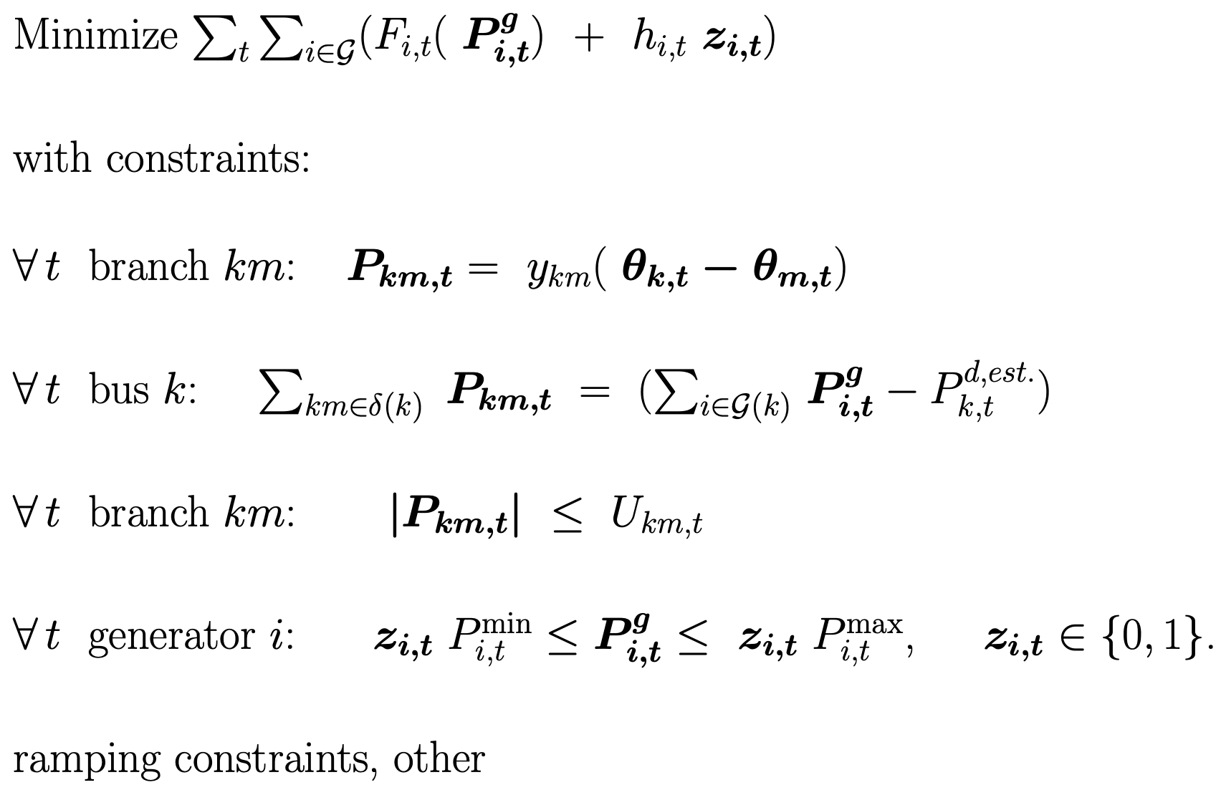
Current work
Joint with Cheng Guo and Yury Dvorkin
Modification of SCUC
Objective: a better representation of the impact of real-time volatility on system cost
Standard SCUC
Instead, use
Real-time volatility-aware SCUC
+ RISK
A measure of the impact of real-time volatility on
real-time cost, as a function of the day-ahead decisions.
Robust
Data-driven: PCA factor stressing
Large-scale MIP solved using branch-and-cut

Slide 26
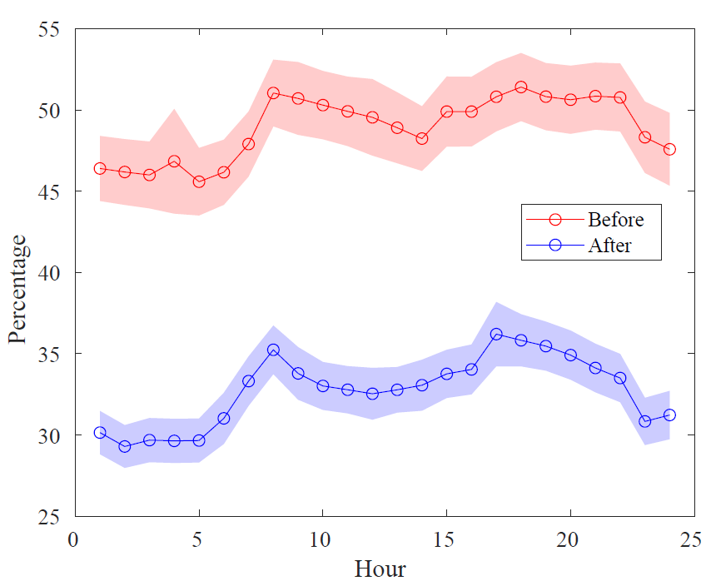
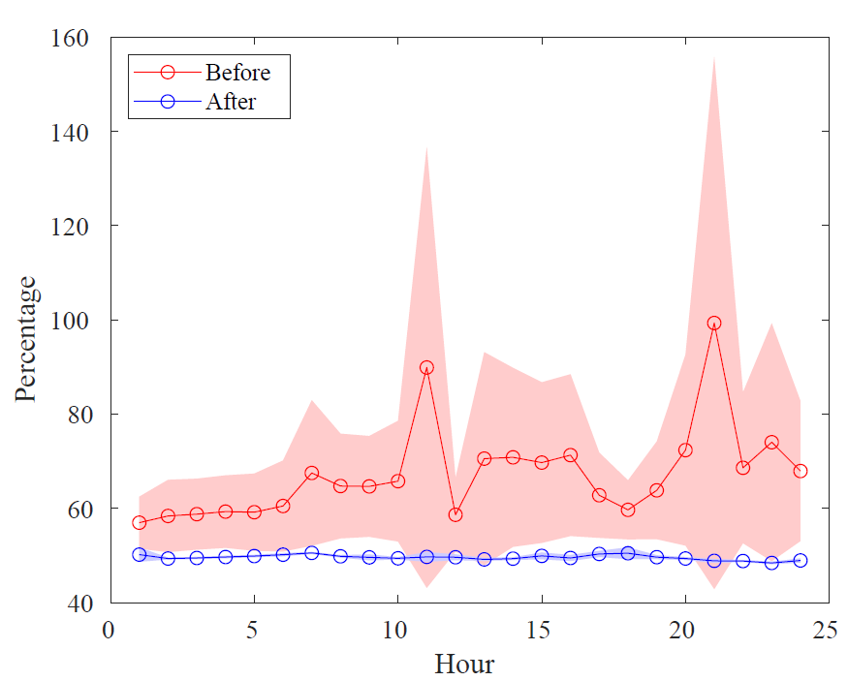
Current work Agostino Capponi, Garud Iyengar and Bo Yang
Game-theoretic analysis of virtual bidding
Theoretical analysis
Studies impact of virtual bidding on price convergence
LSEs bid strategically to minimize costs
Real-time load variability helps disguise strategy
Analysis with and without renewable participation
Renewable variability helps LSEs
Virtual bidders have purely financial objectives
Finding: price convergence is achieved when
competition among virtual bidders is perfect
Finding: LSE day-head bids are decreased if DA renewable bids are introduced.
Ratios of DA to RT hourly demand before and after the initiation of virtual trading
NYISO
CAISO

Slide 27
Current work : Linear relaxations of ACOPF
with Matías Villagra, PhD student
Motivation
There is a growing opinion that AC models should be used to run the markets (both DA and RT)
Scalability? Speed? In the MIP, multi-period, security constrained version? In the RT version?
But … how about prices?
Partial answer: there are accurate SOC relaxations to ACOPF, even in large cases.
But the SOC relaxations are the opposite of fast. Why?
Outer approximations?

Slide 28
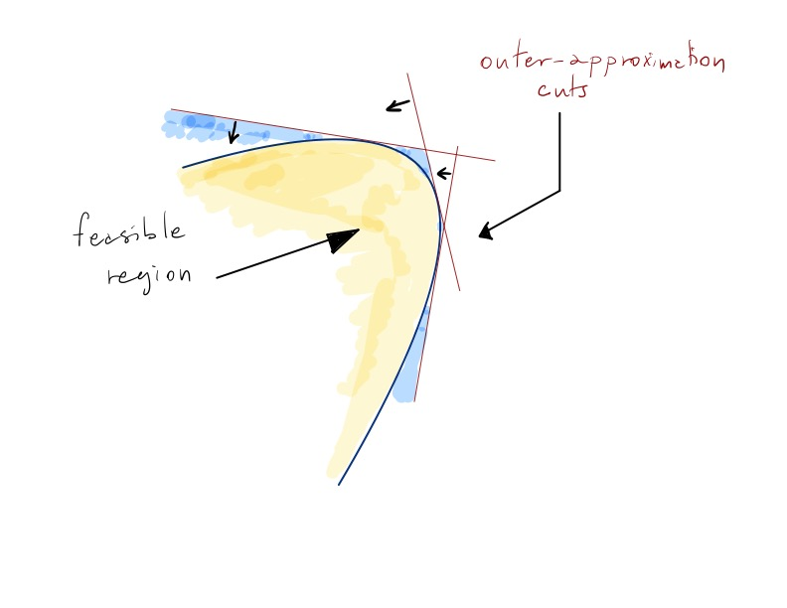
Outer envelope approximation of convex second-order or quadratic constraints
Potential pitfalls:
Many cuts may be needed to accurately approximate a quadratic
Cuts may be nearly parallel
In ACOPF, many SOC constraints need to be accurately approximated
We may succeed in revealing a global feature, at a cost
Consequently, the resulting linearly constrained problem may prove challenging

Slide 29
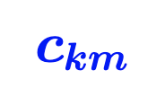
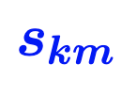
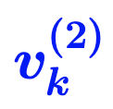
Replace nonlinearities with new variables:
Jabr inequality
Implies generator-to-load
Flow Conservation, including losses
This means that
Total generation = Total Loads + Losses
Outer-envelope cut for Jabr

Slide 30
Ongoing work: Cutting-plane algorithm for solving SOC relaxations
1. Outer-envelope cuts for all SOC, quadratic inequalities
2. Cut management
(a) Remove old cuts that are slack enough
(b) Discard cuts if “too parallel” to existing cuts
3. ACOPF objective is convex quadratic in many libraries, so not quite an LP
4. Using Gurobi barrier as solver
5. Warm starts!!! If we have handled a problem instance, and the data changes … why, reuse the cuts!
This is crucial because in ACOPF there is should be, always, a prior run, for similar conditions

Slide 31
Cutting-Plane vs SOCP (GRB)
Case | Cutting-Plane | SOCP (GRB) | AC (Knitro) / Time
ACTIVSg2000 | 1226298.06 10.60 s | Did not converge 3.31 s | 1228892.08 2.68 s
2869pegase | 133874.82 24.04 s | 133876.95 2.74 s | 133999.29 15.71 s
3375wp | 7393163.64 25.30 s | Did not converge 5.16 s | 7412072.2 6.60 s
6468rte | 86622.07 36.48 s | Did not converge 16.89 s | 86829.02 59.19 s
9241pegase | 309531.22 98.07 s | Did not converge 13.96 s | 315911.56 65.44 s
ACTIVSg10k | 2476814.03 58.80 s | Numerical trouble 66.28 s | 2485898.75 40.89 s
13569pegase | 379356 85.36 s | Did not converge 40.87 s | 386106.56 91.06 s
ACTIVSg25k | 5992309.54 90.50 s | Numerical trouble 134.27 s | 6017830.61 54.55 s
ACTIVSg70k | 16168968.20 100 s | Numerical trouble 226.13 s | 16439499.84 174.72 s
Params (GRB): method = Barrier without CrossOver, BarHomogeneous = 1, NumericFocus = 1, BarConvTol = 1e-6, FeasibilityTol = 1e-6, OptimalityTol = 1e-6
Termination criteria (CP): TimeLimit = 100s or MaxIterations = 100 or ObjImprovement < 1e-5 for 2 consecutive iterations
Machine Specs: Apple M2 Pro, 10 cores, 16 GB RAM | (Knitro) Intel(R) Xeon(R) CPU E5-2687W v3 @ 3.10GHz, 20 cores, 256 GB RAM

Slide 32
Very important feature: the prior run
ACOPF problems, in the real-world are never rarely run “from scratch”.
Rather, they are run with a prior solution vector available.
This vector corresponds to a solution previously (recently) computed for a prior (recent) data realization.
Examples: some loads have changed (a bit). A few generators may be turned off, and a few, turned on. Some branches may be turned off/on.
The aggregate change will not be large.
New solution amounts to a migration from the prior solution. The migration is constrained.
Can we take this information into account, when solving a relaxation?
YES!

Slide 33
Warm-Started LP-based Relaxation
Loads perturbed Normal(5%,5%)
Case Name | Warm-started Relaxation / Time | SOCP (GRB) /Time | SOCP (Knitro) / Time | AC (Knitro) / Time
2383wp | #cuts = 2713 INFEASIBLE 0.59 s | NC 2.39 s | NC 484.97 s | LOC INF 23.81 s
2869pegase | #cuts = 8263 141064.97 1.07 s | 141078.61 2.47 s | 141078.60 6.30 s | 141221.09 19.46 s
6468rte | #cuts = 12755 91590.15 2.06 s | NC 15.44 s | 91606.60 26.57 s | LOC INF 126.38 s
9241pegase | #cuts = 29703 326435.86 8.52 s | NC 13.44 s | 326172.43 40.58 | 332856.71 24.84 s
ACTIVSg10k | #cuts = 18249 2642207.04 4.57 s | NT 53.67 s | 2634748.87 24.41 s | 2654928.94 97.49 s
13569pegase | #cuts = 38047 379914.56 9.95 s | NC 40.58 s | 379617.72 41 s | 386580.87 149.84 s
ACTIVSg25k | #cuts = 43175 6372978.93 11.80 s | NT 83.03 s | 6346601.18 110.30 s | 6407815.19 56.5 s
ACTIVSg70k | #cuts = 110106 18444551.55 32.07 s | NT 293.12 s | 18455505.44 614.14 s | 18872520.7 210.37 s
Parameters (Gurobi and CP): method = Barrier, BarHomogeneous = 1, NumericFocus = 1, BarConvTol = 1e-6, FeasibilityTol = 1e-6, OptimalityTol = 1e-6
Parameters (Knitro): feastol_abs = 1e-03, opttol_abs = 1e-3, blasoptionlib = Intel MKL, numthreads = 20 linsolver = MA97
NC = Did not converge, NT = Numerical trouble encountered, LOC INF = Problem may be locally infeasible
Machine Specs: Apple M2 Pro, 10 cores, 16 GB RAM | (Knitro) Intel(R) Xeon(R) CPU E5-2687W v3 @ 3.10GHz, 20 cores, 256 GB RAM

Slide 34
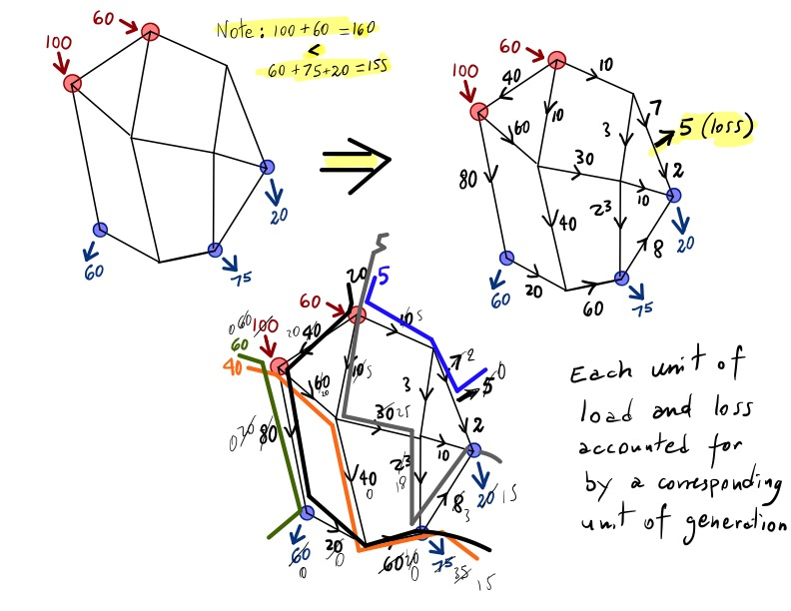
Flow decomposition

