Slide 1
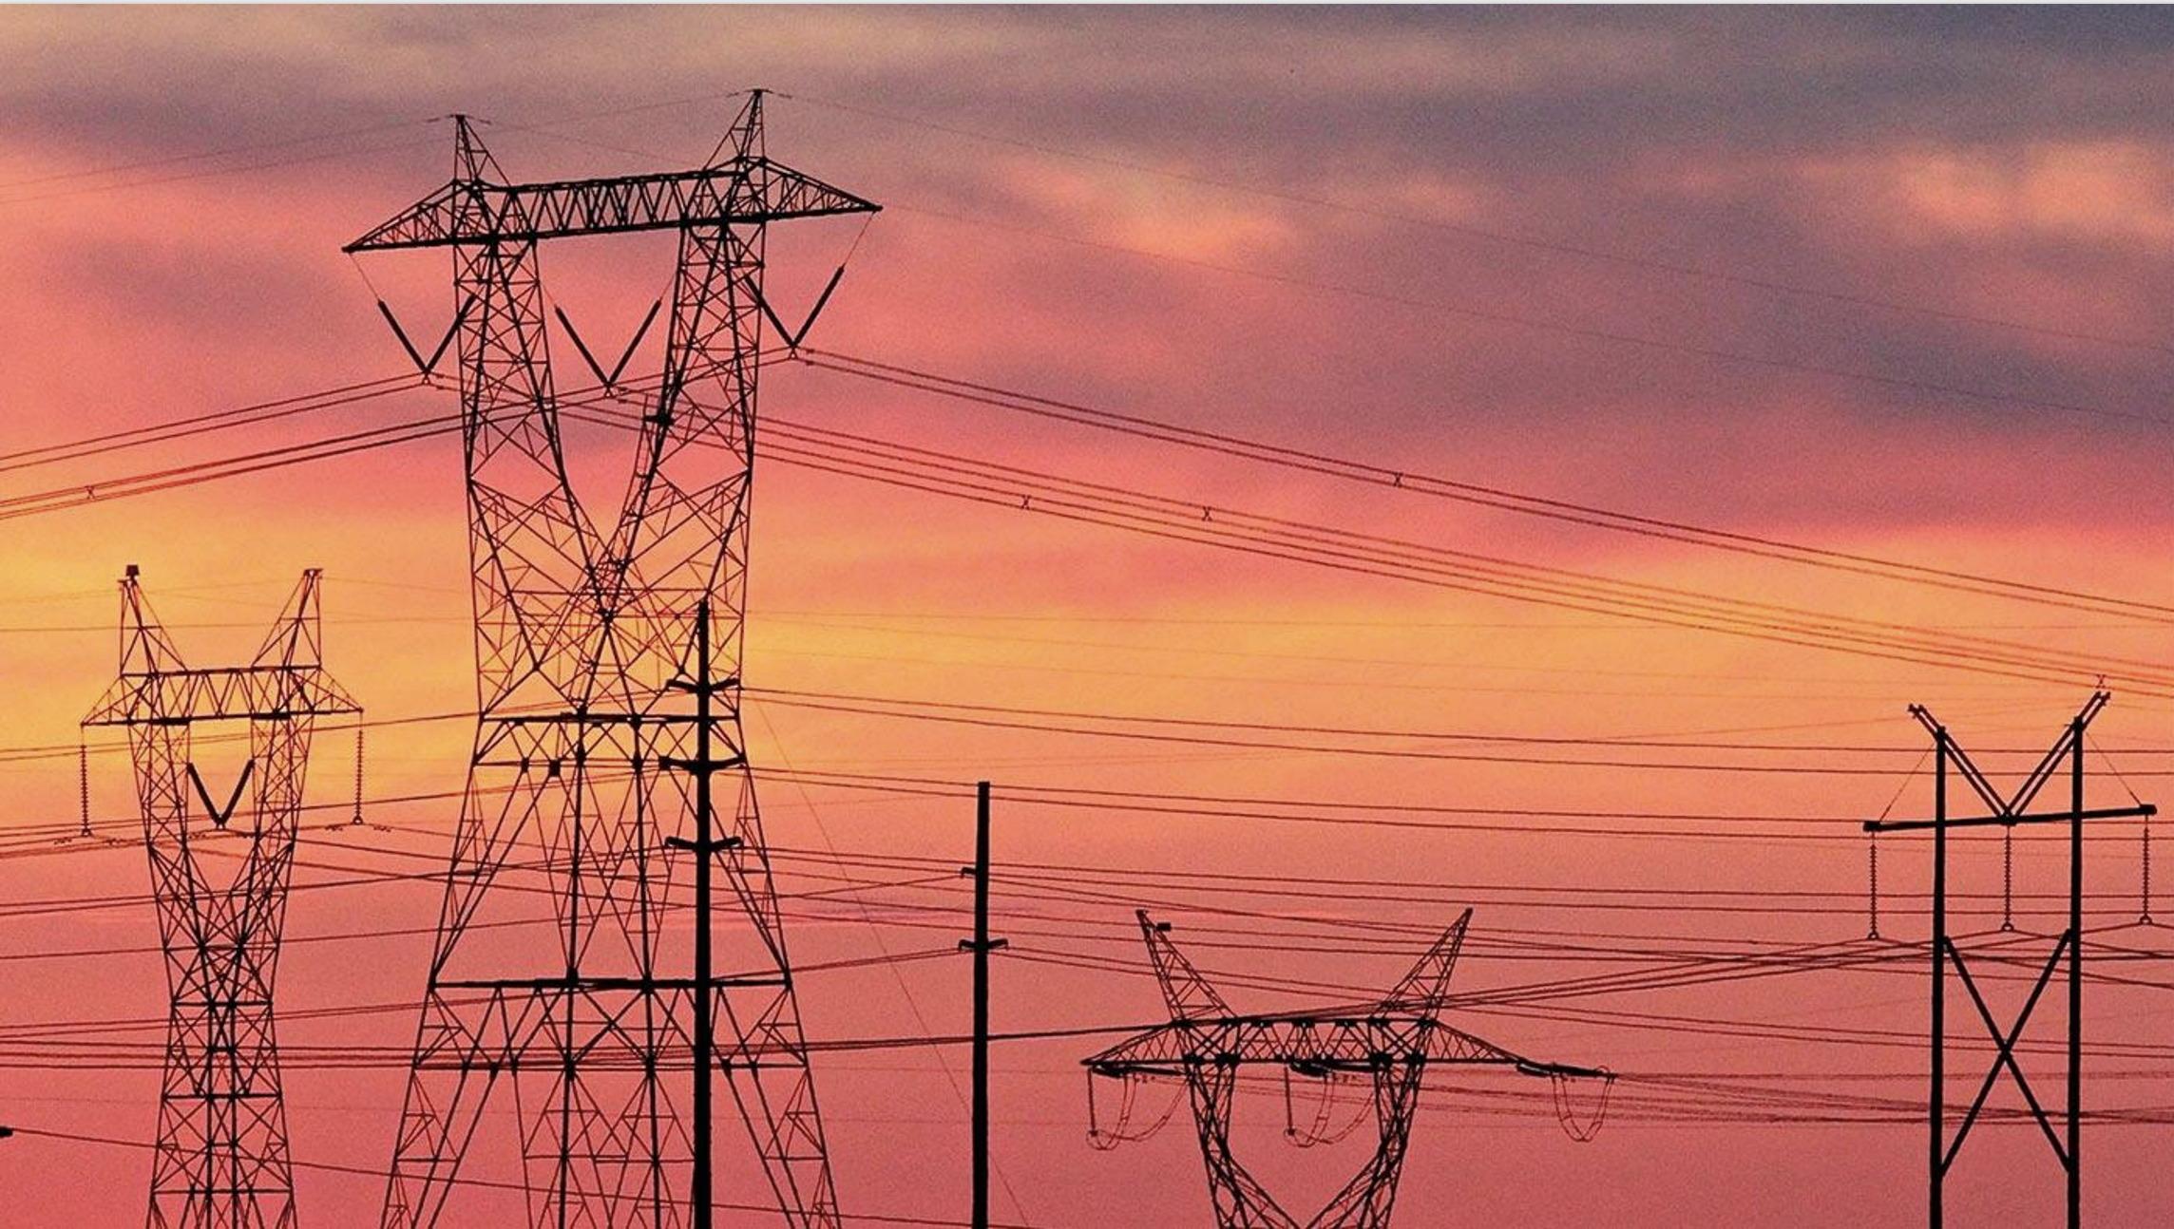
Heuristics for the GO competition
Daniel Bienstock, Columbia University
Richard Waltz, Artelys

Slide 2
Some elements of our approach
Underlying solver: Knitro. Almost included Gurobi, as well, but out of time.
Python. Why. We envisioned switching to a C-based approach, eventually.
AMPL. Why? Interior-point methods require that the gradient and the Hessian of each constraint be provided at each iteration via a callback. AMPL seems quite capable in this regard.
However, there are limitations/bottlenecks in AMPL, especially in high-dimensional cases.
In the Python setup, AMPL apparently prefers the use of Pandas dataframes as a kind of universal data structure.
However, we saw some performance issues.
Moreover, there were some performance issues (not clear whose) regarding how to model dense nonlinear constraints.
Reader. We used the basic JSON setup in Python to read the data in. No performance issues in the large cases.
However, we had some issues digesting the documentation.
Moreover, some of the provided JSON files were unkindly structured: one run-on line of text, with no carriage returns.
This made it quite difficult to understand/debug the data.
Evaluator. We modified the provided evaluator and incorporated into our code.
Note: the evaluation code also appeared to check the input (?) data for consistency.

Slide 3
Basic structure of our method*
Not much attention paid to contingencies in our submitted code – out of time. More later.
Many different methods run in parallel. Pick the best one that terminates on time.
On small instances, MINLP solver included in Knitro
On larger instances, solve relaxation, then round and resolve
Many numerical tricks involving Knitro
1. Tolerances and convergence parameters
2. Starting point: flat start, prior solution, other
3. Sometimes, force strict feasibility for certain constraints (e.g., line limits)
Heuristic for patching connectivity constraint
1. Typically, paying no attention to connectivity constraint seemed to work. But not always.
2. Compute a minimum number of ‘off’ branches to restore to ‘on’, and resolve.
Exploit independence with respect to time, whenever possible
* We experimented with many approaches! A lot of wasted time.

Slide 4
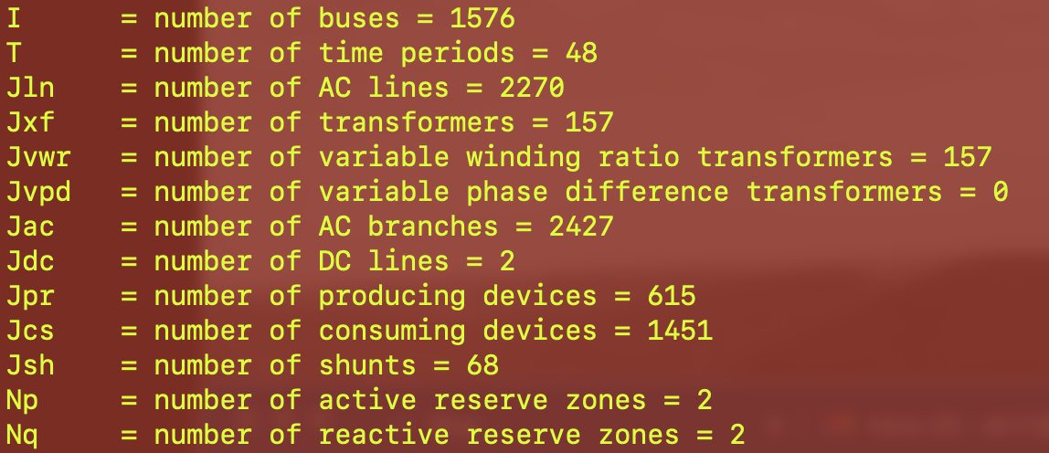

Slide 5
Time-(nearly) independent cases
A relatively frequent feature: no ”forced-on” or “-off” constraints on devices, no max energy intervals, etc.
In fact, sometimes (often?), nothing was period dependent.
In that case, one can solve a 1-period problem, and obtain a feasible solution with all devices and branches on.
Or, a model with 3 periods, where the first two are used to switch devices or branches. (not implemented)
More generally, there may be a small (really small) number of time periods where a change may be necessary.
In such a case, one could solve an equivalent problem over a small number of time-periods.
Scalability, i.e., size of problem provided to Knitro, was often an issue for us.
Often, for example, the interval-based constraints for producers/consumers were on aligned intervals.
And only involving a few of the ‘devices’.
We are sure we did not exploit not sure we exploited these features to the maximum possible!
General idea: first find a (hopefully good) fully feasible solution.
Then follow with local search/branching (in the MIP sense).
A major challenge for me is that I was never convinced that I fully understood the formulation!

Slide 6
We almost completed: linear MIP heuristics for setting binary variables
Obvious strategy: take all nonlinearities away, and get a good solution to the resulting linear MIP
Then fix binary variables and handle remaining nonlinear but continuous problem
Use Gurobi for MIP, Knitro for nonlinear problem
Strategy seemed to work – Gurobi computes good solutions fast, even for the largest cases. But no time to test.
Several versions for the linear MIP:
Remove all power flow variables and injection constraints. Goal is to find a feasible binary solution (on/off generator decisions) that handles the reserves constraints as well as the various interval constraints.
Keep the power flow variables, and the node injection constraints, but remove the nonlinear power flow equations used to define power flow variables.
In #1 or #2, only keep a subset of the reserves constraints – in some cases the quantity of such constraints varied considerably and setting (many) reserve variables to zero was feasible.
Did not get to try a DC model. Not sure it would help.

Slide 7
In GO3, each contingency consists of a branch loss
Post contingency, only active power flows are modeled
A DC power flow model is used – phase angles are controllable
Bus injection mismatches are penalized
Most important feature: line overloads are penalized. Laplacian pseudoinverses give flows as linear functions of bus power balance values.
We can express everything through appropriate inequalities; what is the problem? AMPL.
One problem, for us: very high-dimensional optimization problem
A blast from the past:
We did not have time for: adequate modeling of contingencies

Slide 8
Alternative*: a blast from the past
Use maximum overload, maximized over all the contingencies, rather than sum of overloads
For example. Or, a sum of powers of relative flow values (ratio of flow to line limit).
We still need a compact representation
That is to say, we can approximate the removal of a branch by letting its reactance go to infinity
We can treat reactance as a variable, for each branch that appears in a contingency.
Reactance = original value + a fraction of a large number, M. Sum of fractions = 1.
This defines a corresponding B matrix, and corresponding flows using the pseudoinverse.
There is a compact representation for the gradient, and the Hessian, of the max line overload (see above reference).
Moreover, the corresponding optimization problem (maximize the max line overload) is (very) quickly solved, and can be recursively called.
Effectively, the representation is of same size as the network, not network times number of constraints.
* = same AMPL impediment as before

Slide 9
Some issues we had difficulty with
Difficult to search documentation
Please: provide hyperlinks in the document!
Data and formulation document used different notation. We understand this was unavoidable.
Computation of intervals!

Slide 10
What we would like to see in GO4
Day-ahead markets with genuine uncertainty for real-time.
In other words, multi-time period ACOPF SCUC with realistic uncertainty.
Better notation (and links).
All constraint data pre-computed! Including intervals! Part of the input!
Thanks ARPA-E! Especially the PNNL guys.

