Slide 1
TIM-GO Experience in GO Challenge 3
Andy Sun
Iberdrola-Avangrid Professor
Massachusetts Institute of Technology
Notes:
Primary goal of short pitch + panel session:
Create excitement around your approach – move towards tech to market (e.g., partnerships)
NOTE:
Each team presentation is 5 minutes. Tight.
This is a fast presentation on who you are, key takeaway points, SOA push, most importantly where you want to go from here – T2M, partnerships, etc.
After the teams’ short pitch, the remaining hour will be for a panel discussion so you will have more time to openly discuss/add to your pitch
And you will also have the poster session

Slide 2
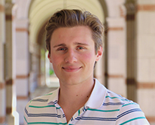
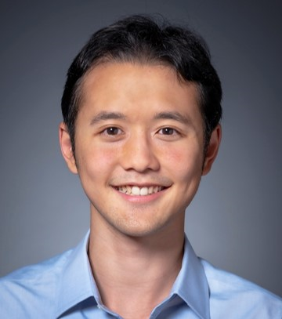
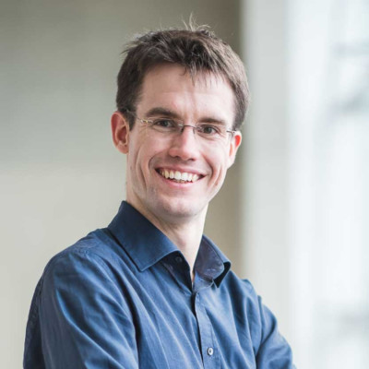
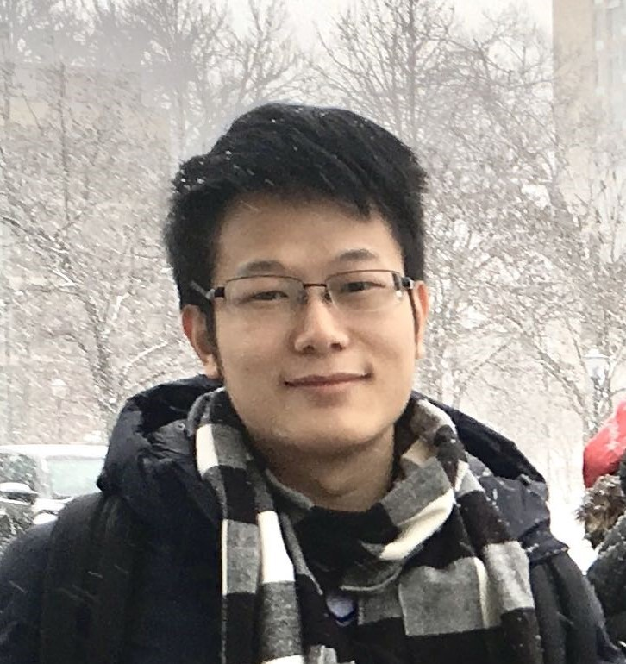
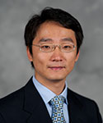
TIM-GO Team
TIM-GO Team Members
Real Drivers:
Matthew Brun
Thomas Lee
Dirk Lauinger
Xin Chen
Prof. Andy Sun (PI)
Grid Optimization

Slide 3
Progression of ARPA-E GO Challenges
Disjunctive-SC-ACOPF in Challenge 1
Single-period AC OPF
Generator & branch (line & transformer) contingencies
Preventive & corrective contingency actions
PV/PQ switching in base & contingency
Up to 30k bus, 35k brch, 3.5k gen, 22k ctg in 10-45min
SC-UC-ACOPF-LS in Challenge 2
Flexible load dispatch
UC decision (1-period both in base-case and ctg)
Branch switching, shunts switch, tap ratios and angles
Up to 31.7k bus, 40k brch, 4.6k gen, 3-9k ctg in 5-60min
Notes:
Challenge 2 has more discrete decisions, less coupling through continuous variables between two stages

Slide 4
Progression of ARPA-E GO Challenges
Multiperiod-SC-UC-ACOPF-LS in Challenge 3
Multi-period UC + AC OPF
Reserves: real & reactive power, zonal & device
Line contingency w. DC power flow (a lot of them!)
“Equal status” of producing and consuming devices
Branch switching (lines, transformers), tap ratio & angles, switched shunts
Up to 23k bus, 32k brch, 27k ctg, 48 periods, in 10min, 2hr, 4hr
Notes:
Challenge 2 has more discrete decisions, less coupling through continuous variables between two stages

Slide 5
Key Challenges in GO 3
Large-scale MINLP with
Spatial coupling: AC power flows, reserves
Temporal coupling: UC, ramping, max/min energy
Two-stage coupling: Base case vs contingencies
Stringent timing requirements: 10 min (up to 23k, 12 periods)
Memory constraints: 200GB esp for 23k

Slide 6
Progression of Our Solution Strategies
Challenge 1:
Primal solution of ACOPF by a local solver
Smoothing of PV/PQ switching disjunction
Contingency selection
ADMM-based decomposition: base vs contingency
An ADMM-based Distributed Optimization Method for Solving Security-Constrained AC Optimal Power
Flow, Gholami, Sun, Zhang, S., Operations Research, 2023

Slide 7
Progression of Our Solution Strategies
Challenge 2:
Both base and ctg are MINLP
UC and LS heuristics to first determine UC & LS solution
UC Heuristics:
Heuristic strategy to find a proper level of gen for a given level of load by ranking generators according to average generation; give a marginal cost
LP-based matching
Line Switching Heuristics:
Determine which lines to turn on based on UC heuristics (marginal gen cost)
Fix UC solution, solve NLP

Slide 8
Progression of Our Solution Strategies
Challenge 3:
UC and ACOPF decomposition
Spatial and temporal decomposition
Model tightening, acceleration
Convex relaxations of ACOPF
Facilitate primal solution
Get dual bounds for performance gaps
Contingency cuts
LS heuristics
Much faster than solving MISOCP
Parallel computation and memory management
Single-node (64-core) multi-threading
256GB memory, 512GB scratch storage
Especially useful for 23k

Slide 9
Test Instances
GO3 has provided many test instances (~600 instances)
Network sizes: 3,14,37,73,600,617,1576,2000,4200,6049,6717,8316,23643
industry cases: 6078
# of time periods:
8-hr (8 0.25-hr, 8 0.5-hr, 2 1-hr)
48-hr (48 1-hr)
7-day (42 4-hr)
Line switching allowed for most cases

Slide 10
Computational Performance
Our codes’ computational performance statistics:
Best solution gap: Avg: 103%, Range: [82%, 1195%]
For 73-bus S4 instances: 15x – 172x better
Global optimality gap: Avg: 99.4%, Std: 2%
Extremely close to global optimality for most cases

Slide 11
Industry Implications
Models and data are realistic:
Division 1 mimics current ISO/TSO real-time markets with 0.25-hr, 0.5-hr, 2-hr look-ahead: solution time 10 min
Division 2 mimics day-ahead markets: solution time 2 hr
Division 3 mimics week-long planning: solution time 4 hr
Current codes capability:
Robust performance in stringent time limits
Extremely high quality solutions (98%-99% close to global opt)
Massive parallelization
Look forward to interacting with industry!

Slide 12
Future Steps
Some missing features:
Uncertainty of production and consumption
Storage dynamics and bidding
Electricity pricing
T&D coordination

Slide 13
Thank You
Dick O’Neill, PNNL team, and all the contributors
All participants to push us and show us what are possible

Slide 14
Contact Information
Andy Sun
Iberdrola-Avangrid Professor in Electric Power System
Sloan School of Management
Massachusetts Institute of Technology
Email: sunx@mit.edu
Tel: 617-324-7443

